Slide 1

TEAM VERSATILE — Vehicle Loan default prediction

Slide 2



team VERSATILE - Members
SYST/OR 568 - DL
Applied Predictive Analytics
Data Analytics Engineering Program
Spring 2023
May 4, 2023
Le, Huong Thi Thu
Hill, Faith
Jarrouje, Tarex
Teh, B. Bloti
Sharma, Indu Priya
Dr. Jie Xu, Associate Professor
Systems Engineering & Operations Research
VOLGENAU SCHOOL OF ENGINEERING,
COLLEGE OF ENGINEERING & COMPUTING
GEORGE MASON UNIVERSITY – FAIRFAX CAMPUS 4400 UNIVERSITY DR MSN 4A7 FAIRFAX, VA 22030
Ph. 703-993-4620
Email: jxu13@gmu.edu

Slide 3
AgENDA
Raw Data Set & Source
About The Data Set
High-level Summary (Raw Data Sets)
Predictors & Responses
Data Preprocessing
Check for Missing Values
Removal of Near-Zero Variance Predictors
Box-Cox Transformation, Centering and Scaling
High-level Summary (Cleaned-up Data Sets)
Predictors & Responses
Predictive Models (Already Tried or Plan To Use)
Classification Tree
Logistic Regression
Random Forest
Roadblocks
Conclusion

Slide 4
TEAM VERSATILE – Data Set
About The Data Set/Project:
Importance/Essence of problem: Financial organizations suffer substantial losses from defaults on car loans, resulting in stricter vehicle loan underwriting standards and higher rejection rates. Consequently, financial institutions are calling for a more effective credit risk scoring model to assess the likelihood of vehicle loan defaults. This necessitates an investigation to identify the factors that contribute to the default of vehicle loans. Doing so will ensure that consumers capable of repayment are not rejected and important determinants can be identified which can be further used for minimizing the default rates.
Prediction
Likelihood of default or nondefault loaner: based on the information collected from the borrower, we can predict the likelihood of that a loan can be returned or not.

Slide 5
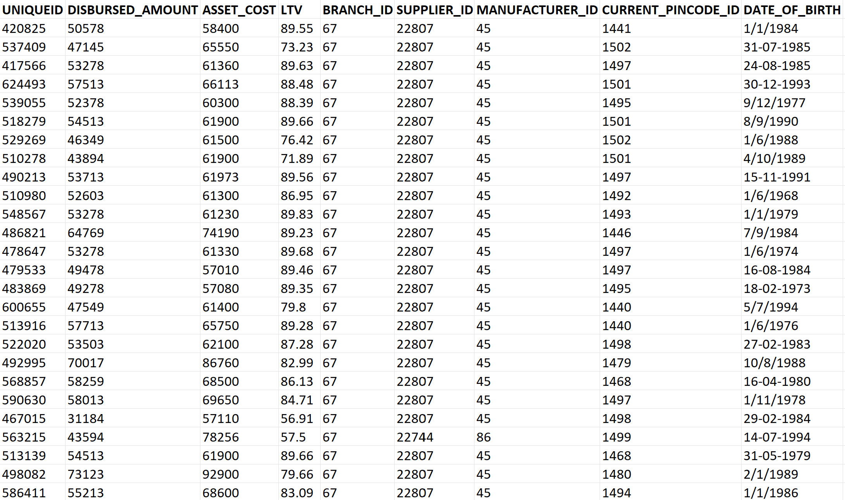
Team VERSATILE – raw data set & source
Project Dataset
Dataset Name: Vehicle Loan
Dataset Owners: Kaggle (Avik Paul)
Dataset Type: Open Source
Dataset Size: 233,154 Obs. & 41 Variables
Below are pieces of information regarding the loan and loanee in the data set:
Loanee Information (Demographic data like age, income, Identity proof etc.)
Loan Information (Disbursal details, amount, EMI, loan to value ratio etc.)
Bureau data & history (Bureau score, number of active accounts, the status of other loans, credit history etc.)
Vehicle Loan Data Dictionary
Variable Name | Description
UniqueID | Identifier for customers
loan_default | Payment default in the first EMI on due date
disbursed_amount | Amount of Loan disbursed
ltv | Loan to Value of the asset
branch_id | Branch where the loan was disbursed
supplier_id | Vehicle Dealer where the loan was disbursed
manufacturer_id | Vehicle manufacturer(Hero, Honda, TVS etc.)
Current_pincode | Current pin code of the customer
Date_of_Birth | Date of birth of the customer
Employment_Type | Employment Type of the customer (Salaried/Self Employed)
Disbursal_Date | Date of birth of the customer
State_ID | State of disbursement
Extract of Vehicle Loan Dataset

Slide 6
Team VERSATILE – raw data set & source
Vehicle Loan Data Dictionary
Variable Name | Description
Employee_code_ID | Employee of the organization who logged the disbursement
MobileNo_Avl_Flag | if Mobile no. was shared by the customer, then flagged as 1
Aadhar_flag | if aadhar was shared by the customer then flagged as 1
PAN_flag | if voter was shared by the customer, then flagged as 1
VoterID_flag | if voter was shared by the customer, then flagged as 1
Driving_flag | if DL was shared by the customer, then flagged as 1
Passport_flag | if passport was shared by the customer, then flagged as 1
PERFORM_CNS_SCORE | Bureau Score
PERFORM_CNS_SCORE_DESCRIPTION | Bureau score description
PRI_NO_OF_ACCTS | count of total loans taken by the customer at the time of disbursement
DELINQUENT_ACCTS_IN_LAST_SIX_MONTHS | Loans defaulted in the last 6 months
Variable Name | Description
PRI_ACTIVE_ACCTS | count of active loans taken by the customer at the time of disbursement
PRI_OVERDUE_ACCTS | count of default accounts at the time of disbursement
PRI_CURRENT_BALANCE | total Principal outstanding amount of the active loans at the time of disbursement
PRI_SANCTIONED_AMOUNT | total amount that was sanctioned for all the loans at the time of disbursement
PRI_DISBURSED_AMOUNT | total amount that was disbursed for all the loans at the time of disbursement
SEC_NO_OF_ACCTS | count of total loans taken by the customer at the time of disbursement
SEC_ACTIVE_ACCTS | count of active loans taken by the customer at the time of disbursement
SEC_OVERDUE_ACCTS | count of default accounts at the time of disbursement
AVERAGE_ACCT_AGE | Average loan tenure

Slide 7
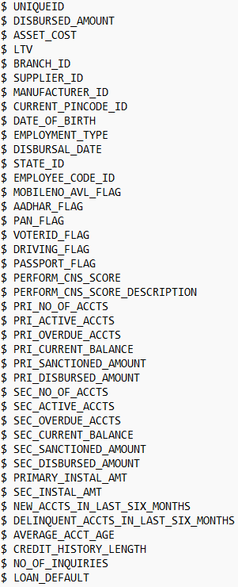
Team VERSATILE – raw data set & source
41 Tentative Predictors:
Response/Outcome: Default or Not Default
Vehicle Loan Data Dictionary
Variable Name | Description
SEC_CURRENT_BALANCE | total Principal outstanding amount of the active loans at the time of disbursement
CREDIT_HISTORY_LENGTH | Time since first loan
NO_OF_INQUIRIES | Enquires done by the customer for loans
SEC_SANCTIONED_AMOUNT | total amount that was sanctioned for all the loans at the time of disbursement
SEC.DISBURSED_AMOUNT | total amount that was disbursed for all the loans at the time of disbursement
PRIMARY_INSTA_AMT | EMI Amount of the primary loan
SEC_INSTAL_AMT | EMI Amount of the secondary loan
NEW_ACCTS_IN_LAST_SIX_MONTHS | New loans taken by the customer in last 6 months before the disbursement.
Primary (PRI) accounts are those which the customer has taken for his personal use.
Secondary (SEC) accounts are those which the customer act as a co-applicant or gaurantor.

Slide 8
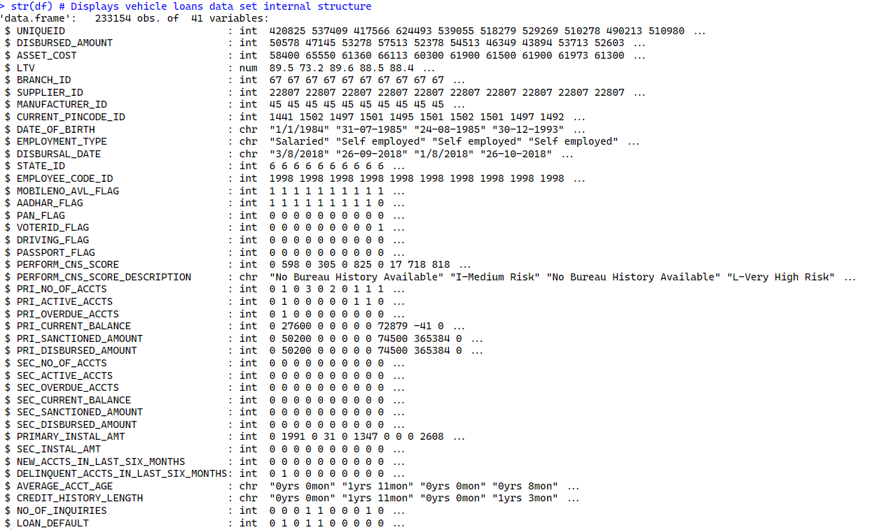
High-level Summary (Raw Data Sets)
Vehicle Loan Data Set (RAW DATA) Internal Structure/Statistics
# Display of "DATE_OF_BIRTH" and # # "DISBURSAL_DATE" data type using # the class fn.
> class(df$DATE_OF_BIRTH)
[1] "character"
> class(df$DISBURSAL_DATE)
[1] "character"

Slide 9
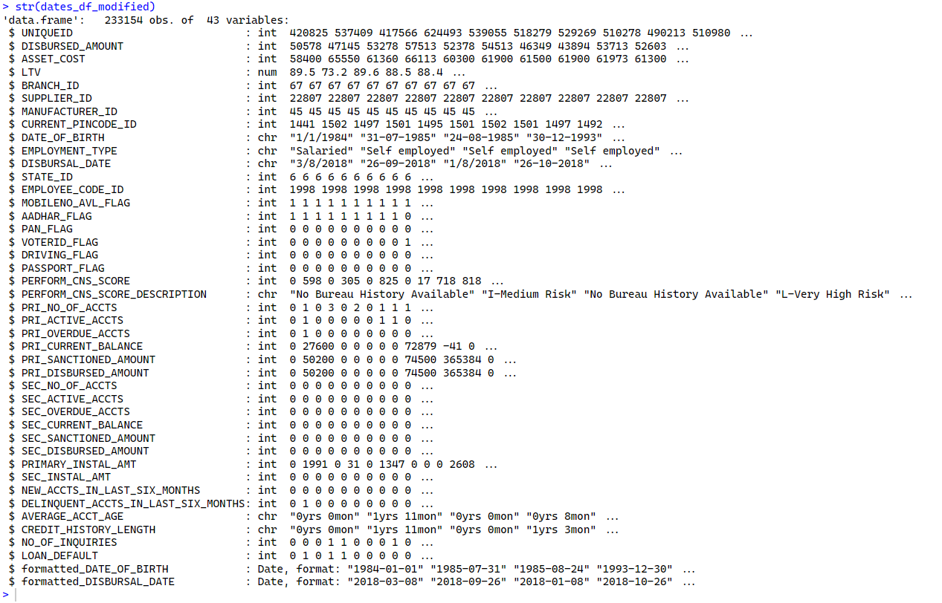
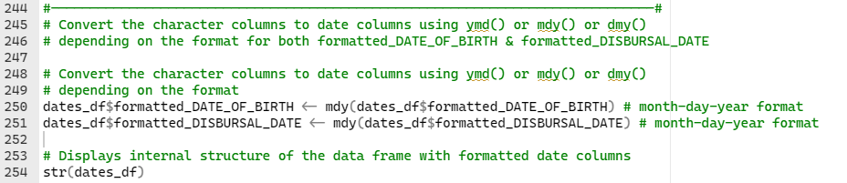
High-level Summary (Raw Data Sets)
Vehicle Loan Data Set (RAW DATA) Internal Structure/Statistics
The lubridate package provides a convenient and user-friendly way to work with dates and times in R.
New formatted date columns
Notes:
The lubridate package is a popular R package used for working with dates and times.
It provides a set of functions that simplify many common tasks related to working with dates and times, including parsing and formatting dates, extracting components of dates and times, manipulating date and time objects, and performing arithmetic operations on dates and times.
Here are some examples of what you can do with the lubridate package:
Parse dates and times from strings using functions like ymd() (year-month-day), dmy() (day-month-year), and hms() (hours-minutes-seconds).
Extract components of dates and times using functions like year(), month(), day(), hour(), minute(), and second().
Manipulate date and time objects using functions like ymd() (year-month-day), dweeks() (days plus weeks), dmonths() (days plus months), and dyears() (days plus years).
Perform arithmetic operations on dates and times using functions like %m+% (add months), %m-% (subtract months), %d+% (add days), and %d-% (subtract days).

Slide 10
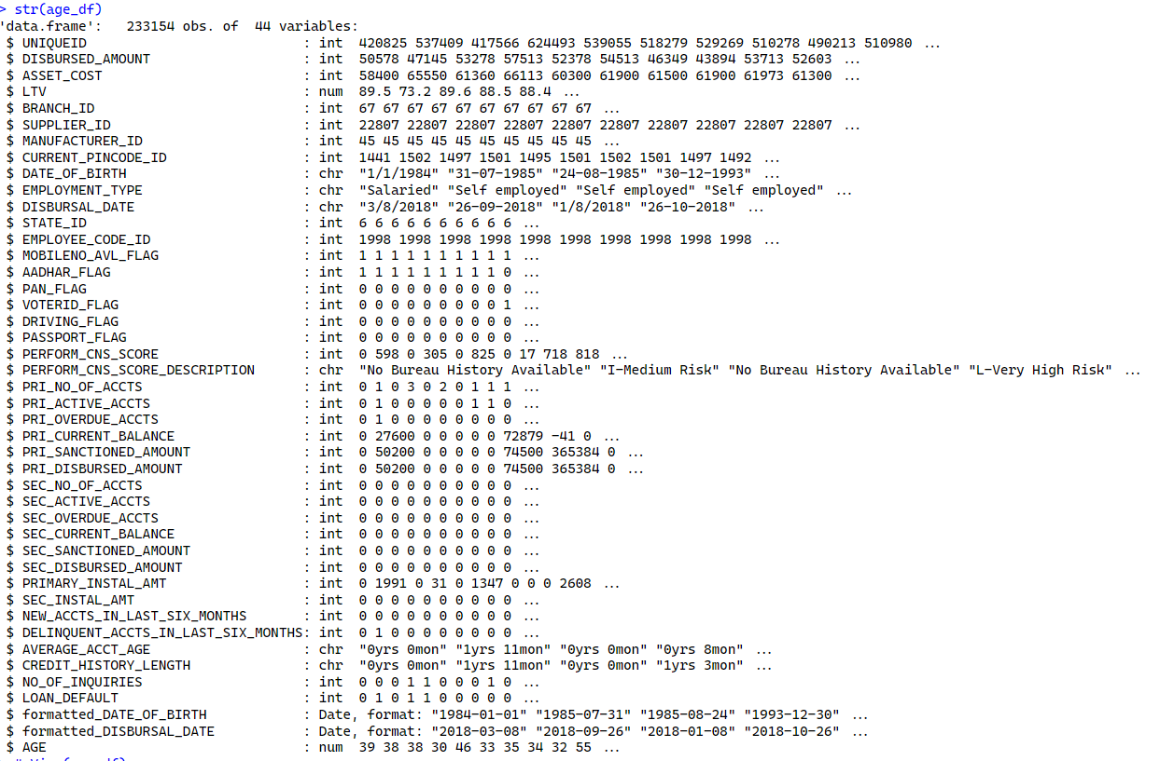
High-level Summary (Raw Data Sets)
Vehicle Loan Data Set (RAW DATA) Internal Structure/Statistics
Added a new column, AGE at the bottom of to the data frame

Slide 11
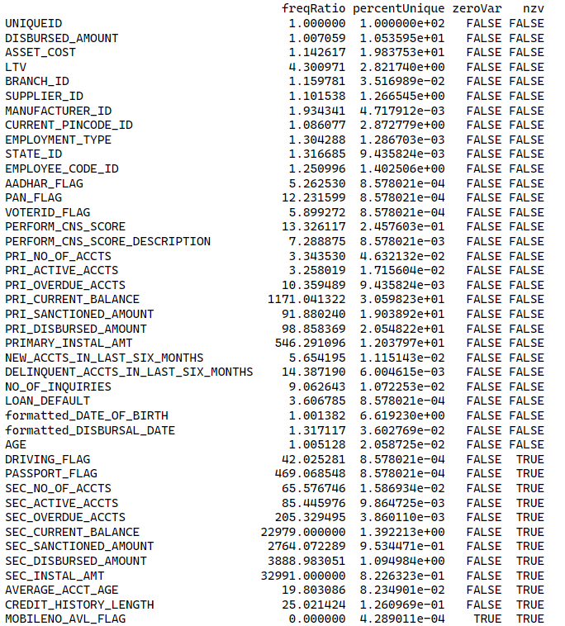
Data Pre-Processing: Removal of Near-zero Variance Predictors
Removal of Near-Zero Variance Predictors
Removal of Near-zero Variance Predictors:
12 data points or non-informative predictors identified during the variable selection process.
30 variables with high predictive capabilities were identified as final PREDICTORS for modeling.
To Be Removed!
12 Near-Zero Variance Variables Identified
Notes:
The caret package is a practical tool that enables a modeler to remove non-informative data points during the variable selection process of data modeling.
Regardless of the modeling process being used, or of the specific purpose for a particular model, the removal of non-informative predictors is a good idea.
Leaving such variables in a model only adds extra complexity, without any corresponding payoff in model accuracy or quality.
For nearZeroVar: if saveMetrics = FALSE, a vector of integers corresponding to the column positions of the problematic predictors.
If saveMetrics = TRUE, a data frame with columns:
freqRatio: the ratio of frequencies for the most common value over the second most common value
percentUnique: the percentage of unique data points out of the total number of data points
zeroVar: a vector of logicals for whether the predictor has only one distinct value
nzv: a vector of logicals for whether the predictor is a near zero variance predictor.

Slide 12
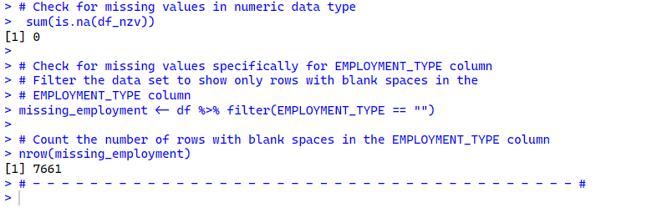
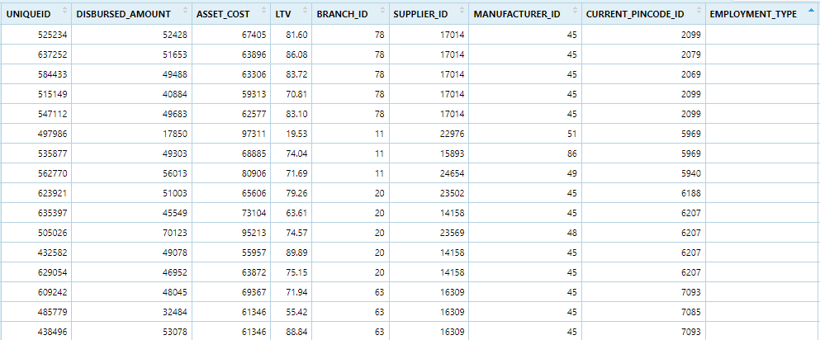
High-level Summary (Raw Data Sets)
Vehicle Loan Data Set (RAW DATA): Missing Values
EMPLOYMENT_TYPE:
7,661 missing values identified

Slide 13
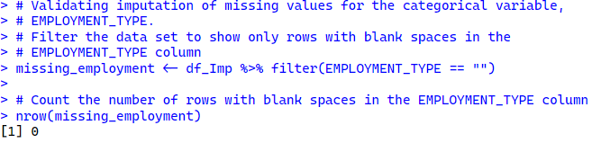
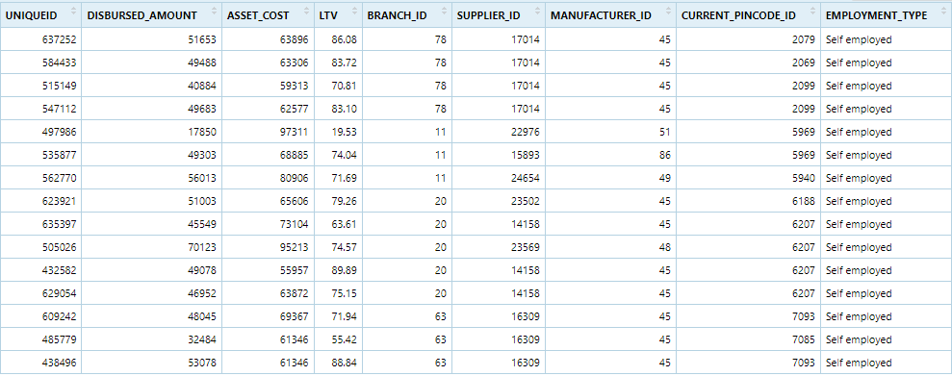
Data Pre-Processing: IMPUTATION (raw data set
Imputation of Missing Values
Dynamic imputation of missing values with mode depending on the data type
Categorical Data: Impute missing values with mode.
EMPLOYMENT_TYPE:
Zero missing values identified AFTER IMPUTATION

Slide 14
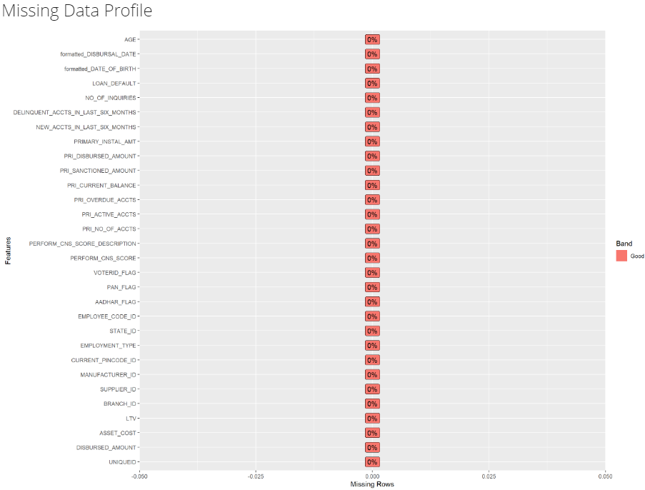
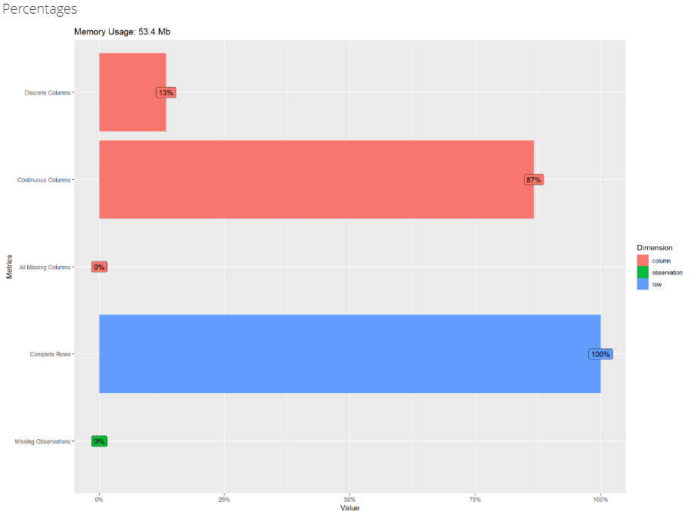
Data Pre-Processing: IMPUTATION (raw data set
Post-Imputation Results
Basic Statistics
Raw Counts
Name Value
Rows 233,154
Columns 30
Discrete columns 4
Continuous columns 26
All missing columns 0
Missing observations 0
Complete Rows 233,154
Total observations 6,994,620
Memory allocation 53.4 Mb
Data Explorer Package displaying missing data profile and basic statistics
Notes:
The DataExplorer package provides a create_report() function that generates a comprehensive report of descriptive statistics for a data set, including measures such as n, missing, distinct, mean, median, Gmd (geometric mean deviation), and many others.

Slide 15
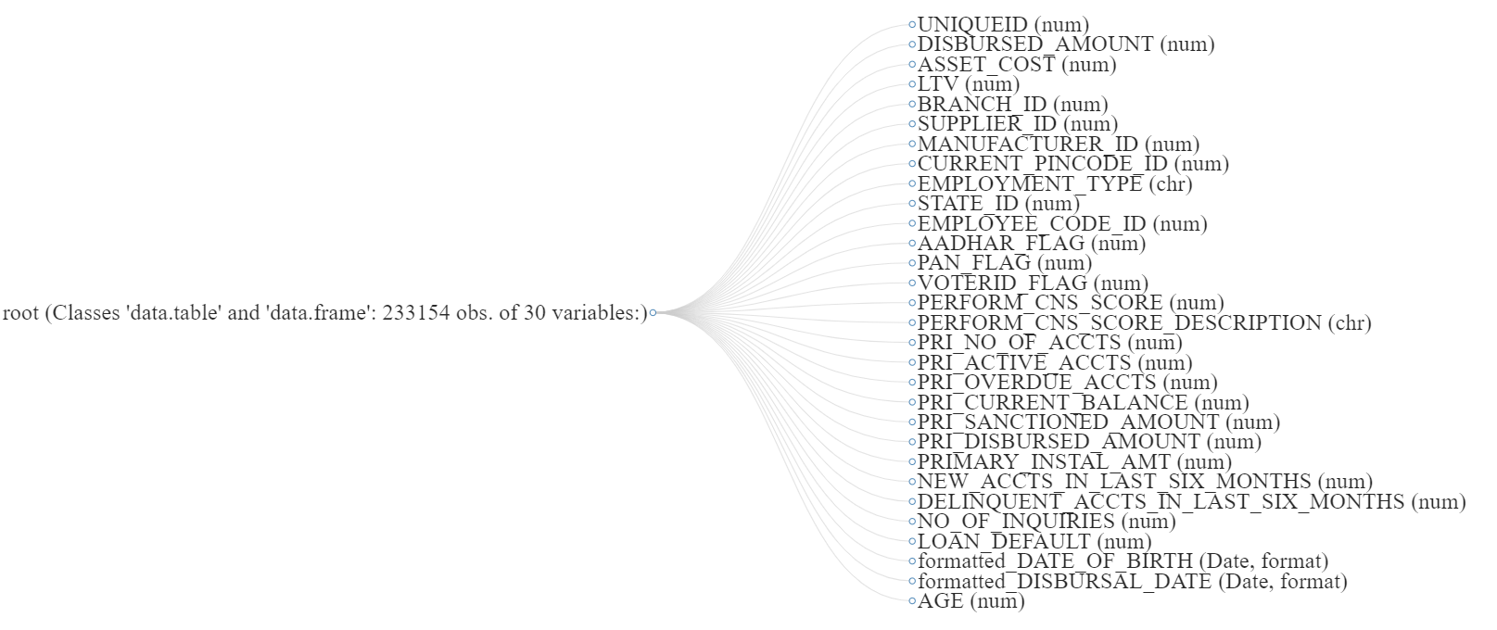

High-level Summary (Raw Data Sets)
Vehicle Loan Data Set (RAW DATA) Internal Structure/Statistics
30 Possible Predictors
Response/Outcome: Default or Not Default
Notes:
The DataExplorer package provides a create_report() function, which was used to generate the data structure (a part of an entire data profiling report).

Slide 16
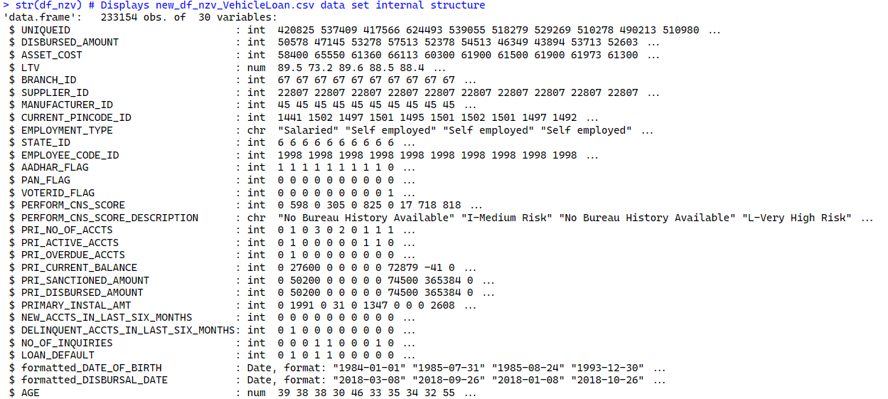
High-level Summary (Raw Data Sets)
Vehicle Loan Data Set (RAW DATA) Internal Structure/Statistics
30 Possible Predictors:
Response/Outcome: Default or Not Default

Slide 17
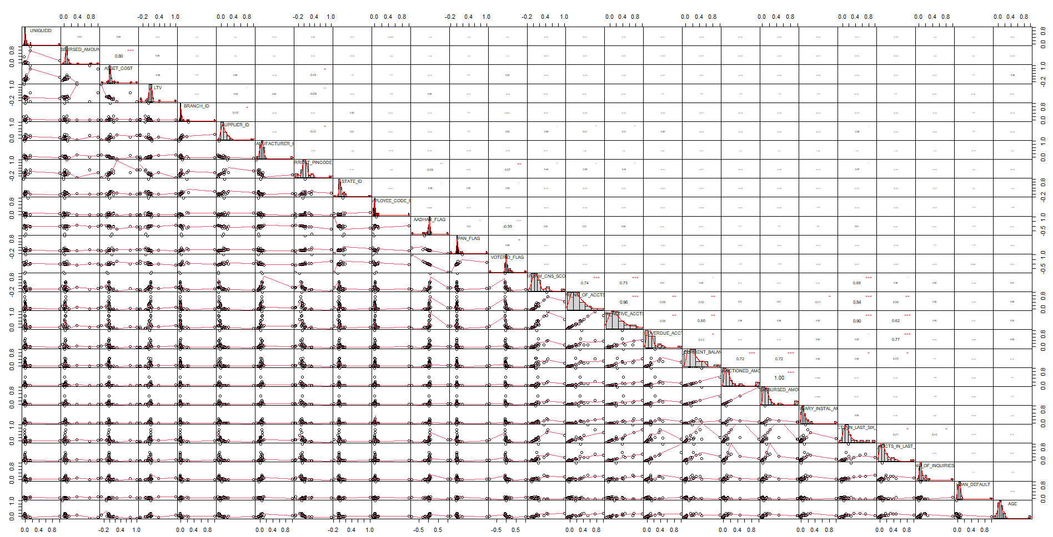
Data Pre-Processing: Correlation plot pre-Near-zero Variance APPLICATION
Correlation Plot: If no stars, the variable is NOT statistically significant, while one, two and three stars mean that the corresponding variable is significant at 10%, 5% and 1% levels, respectively)
Notes:
The chart.Correlation function of the PerformanceAnalytics package was used to create a correlation plot with histograms, density functions, smoothed regression lines and correlation coefficients with the corresponding significance levels (if no stars, the variable is not statistically significant, while one, two and three stars mean that the corresponding variable is significant at 10%, 5% and 1% levels, respectively)

Slide 18
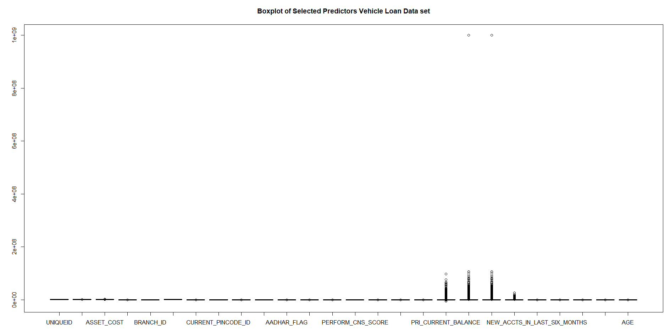
High-level Summary (Raw Data Sets)
Vehicle Loan Data Set (RAW DATA): Identifying Outliers Using Boxplot
Why is it important to identify Outliers?
It is important to identify outliers in a dataset in R (or any other statistical software) because they can have a significant impact on the statistical analysis and modeling results. Outliers are data points that are significantly different from other observations in the dataset, and they can be caused by various factors such as measurement errors, data entry errors, or rare events.
The boxplot above does show example of variables with outliers: PRI_OVERDUE_ACCTS, PRIMARY_INSTAL_AMT, as well as other variables (i.e., NO_OF_INQUIRIES, DISBURSED_AMOUNT, ASSET_COST, etc.)
Notes:
An outlier is a value or an observation that is distant from other observations, that is to say, a data point that differs significantly from other data points.

Slide 19
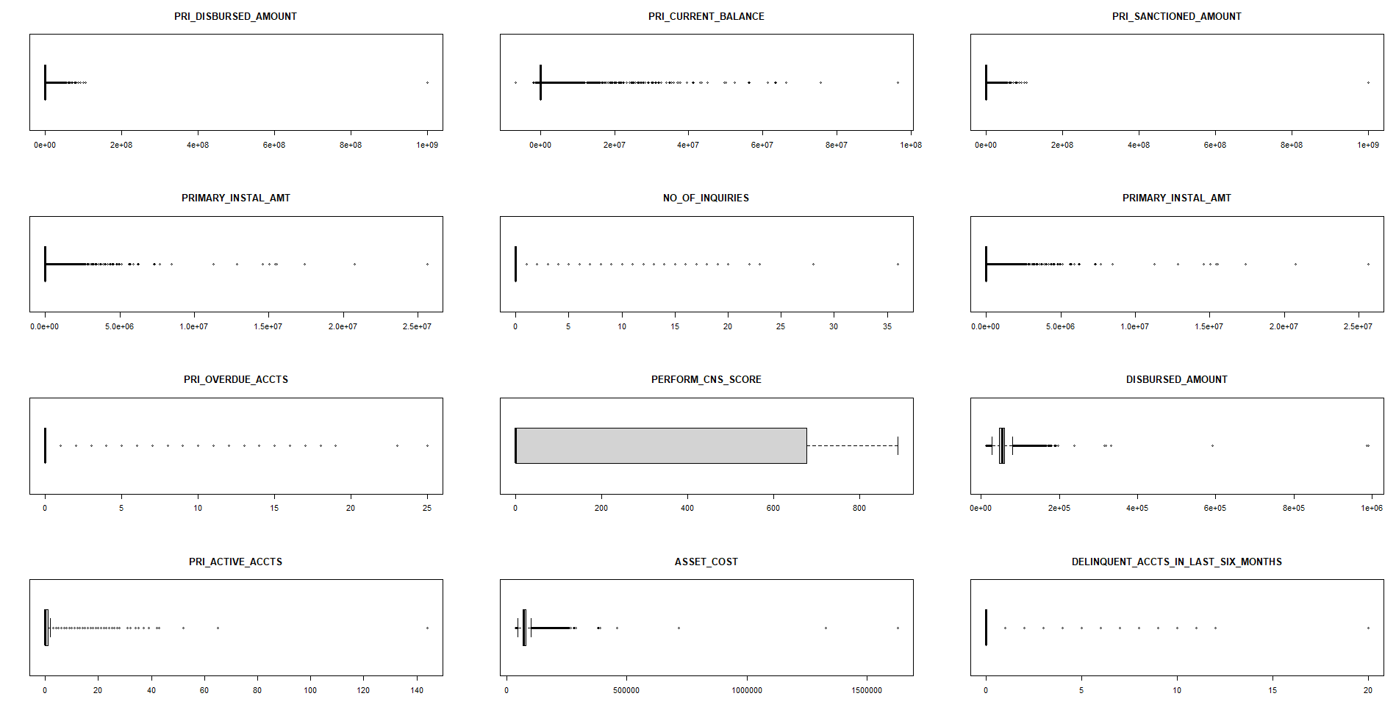
High-level summary (cleaned-up data set)
Boxplot of Selected Predictor Variables
There appears to be outliers in the data set, and some are skewed. Clearly, the dots above/below the ends of the "whiskers" in the boxplots are indications of outliers.

Slide 20
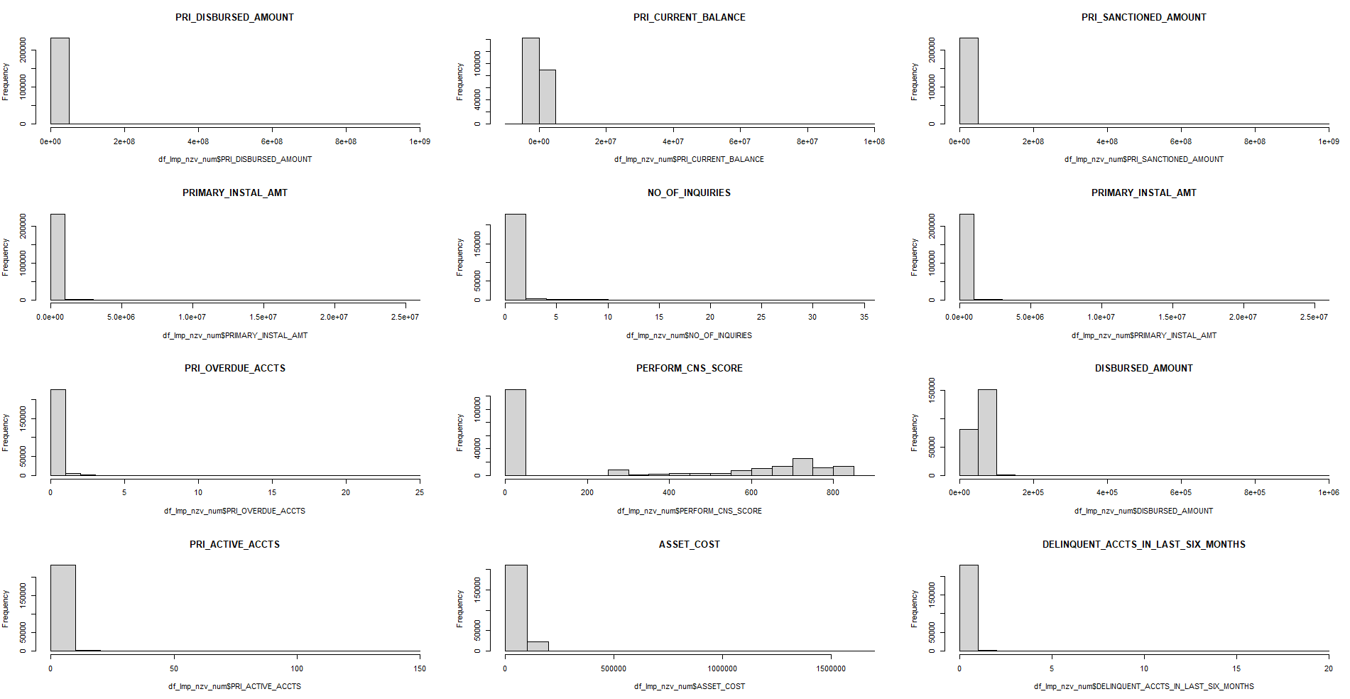
High-level summary (cleaned-up data set)
Histograms of Selected Predictor Variables
There appears to be outliers in the data set, and most of the data points are skewed to the right, which are indicators of outliers. The PERFORM_CNS_SCORE appears to be bi-modal.
Notes:
A histogram that is bimodal has two peaks or two highest main points. These points are not necessarily of the same height.
The two peaks mean that there are two groups in the frequency table that has the most frequency of occurrence.
A variable that is normally distributed has a histogram (or "density function") that is bell-shaped, with only one peak, and is symmetric around the mean.

Slide 21
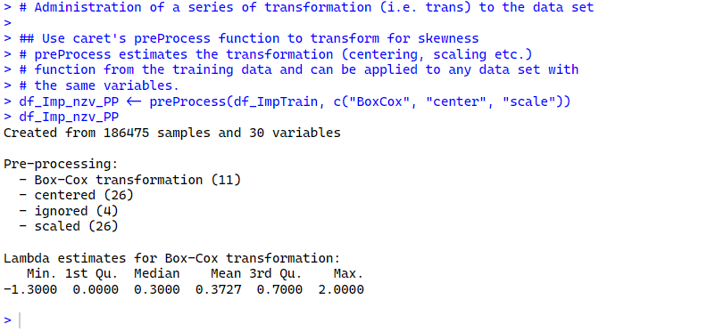
Data Pre-Processing: Box–Cox transform, center, and scale
Notes:
To administer a series of transformations to multiple data sets, the caret class preProcess has the ability to transform, center, scale, or impute values, as well as apply the spatial sign transformation and feature extraction. The function calculates the required quantities for the transformation. After calling the preProcess function, the predict method applies the results to a set of data. For example, to Box–Cox transform, center, and scale the data, then execute PCA for signal extraction, the syntax would be:

Slide 22
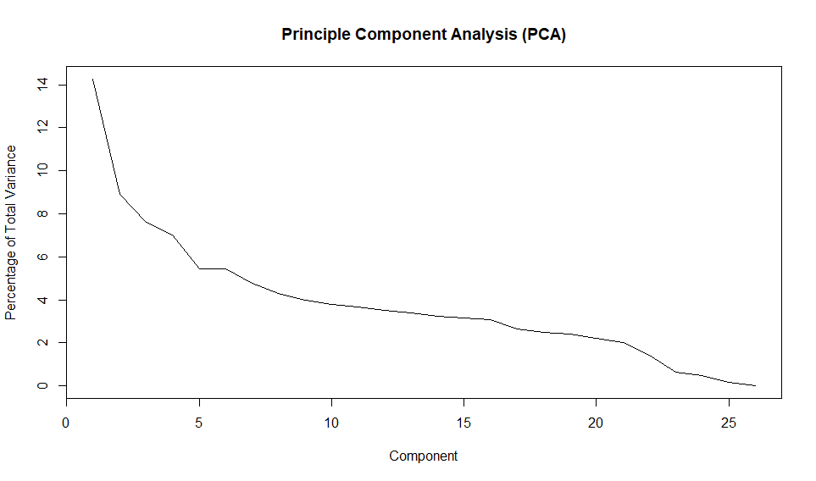
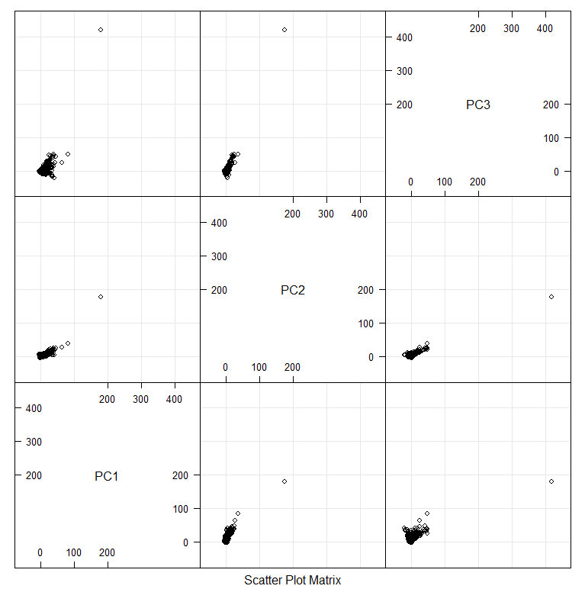
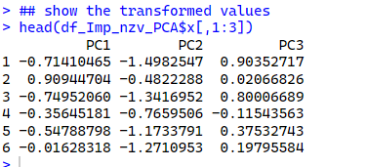
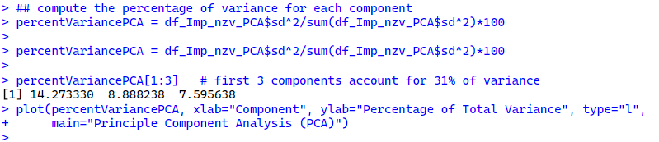
Data Pre-Processing: PCA
Scatter Plot Matrix of the First Three Components
Notes:
PCA (Principal Component Analysis) is a technique for reducing the dimensionality of a dataset while retaining as much of its variance as possible. In the context of modeling in R, PCA can be used to pre-process the predictor variables before fitting a model, in order to reduce their dimensionality and improve the performance of the model.
PCA is particularly useful when dealing with datasets that have a large number of predictor variables, which can lead to overfitting and decreased performance of models. By transforming the original predictor variables into a smaller set of principal components, PCA reduces the number of variables while retaining as much information as possible. This can improve the accuracy and interpretability of the model, as well as reduce computation time and memory usage.

Slide 23
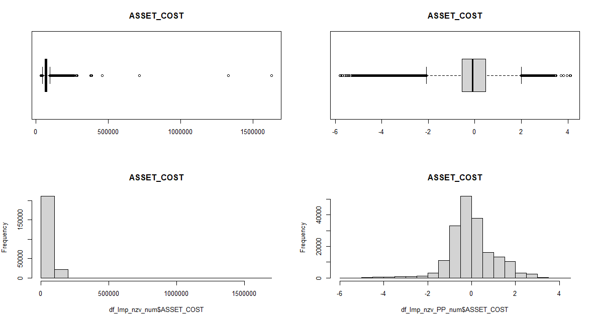
High-level summary (cleaned-up data set)
Comparison of Box plots & Histograms BEFORE & AFTER Clean-Up

Slide 24
Predictive models
Predictive Models: Linear Classification Models
Classification Tree
Logistic Regression
Random Forest

Slide 25
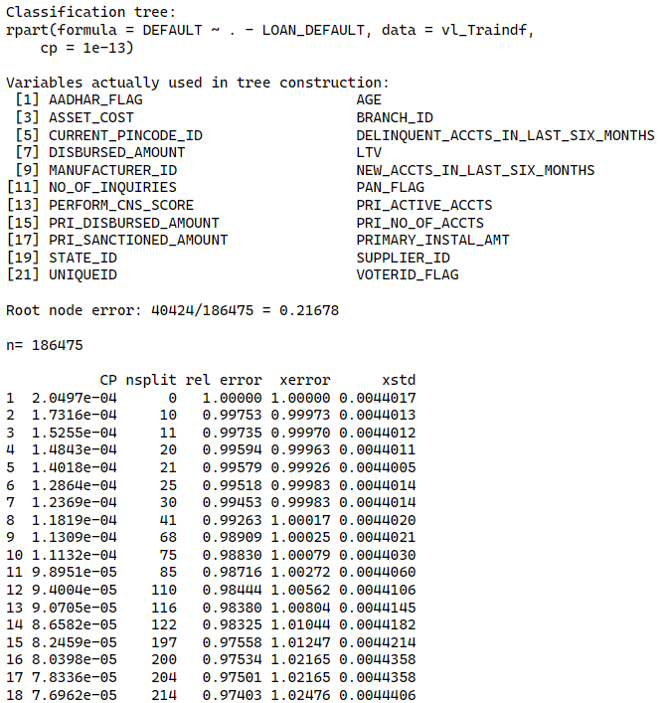
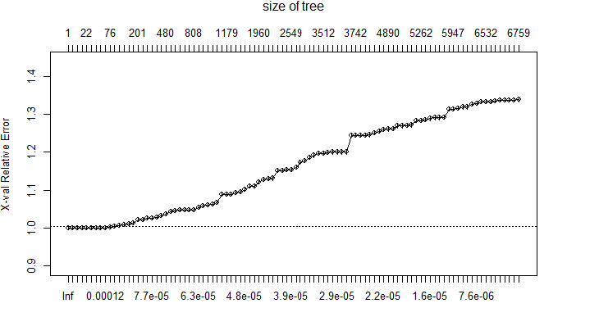
Predictive models
Predictive Models: Linear Classification Models
Classification And Regression Tree (CART) – Decision Tree
Fitting Classification Tree Using rpart
Notes:
Use cross-validation to prune the tree. The plotcp() function in R is used to plot the complexity parameter (cp) values and their corresponding cross-validation error rates for a decision tree model built using the rpart() function in the rpart package. The plotcp() function is useful for selecting the appropriate value of cp to prune the tree and avoid overfitting. It can also help in selecting the optimal number of nodes for the tree.
When you run plotcp() on a fitted CART model, it will create a plot of the cross-validation error as a function of the complexity parameter, along with vertical lines representing the minimum and one-standard-error-rule values of the complexity parameter. The one-standard-error-rule value is the largest value of the complexity parameter that still has a cross-validation error within one standard error of the minimum cross-validation error.

Slide 26
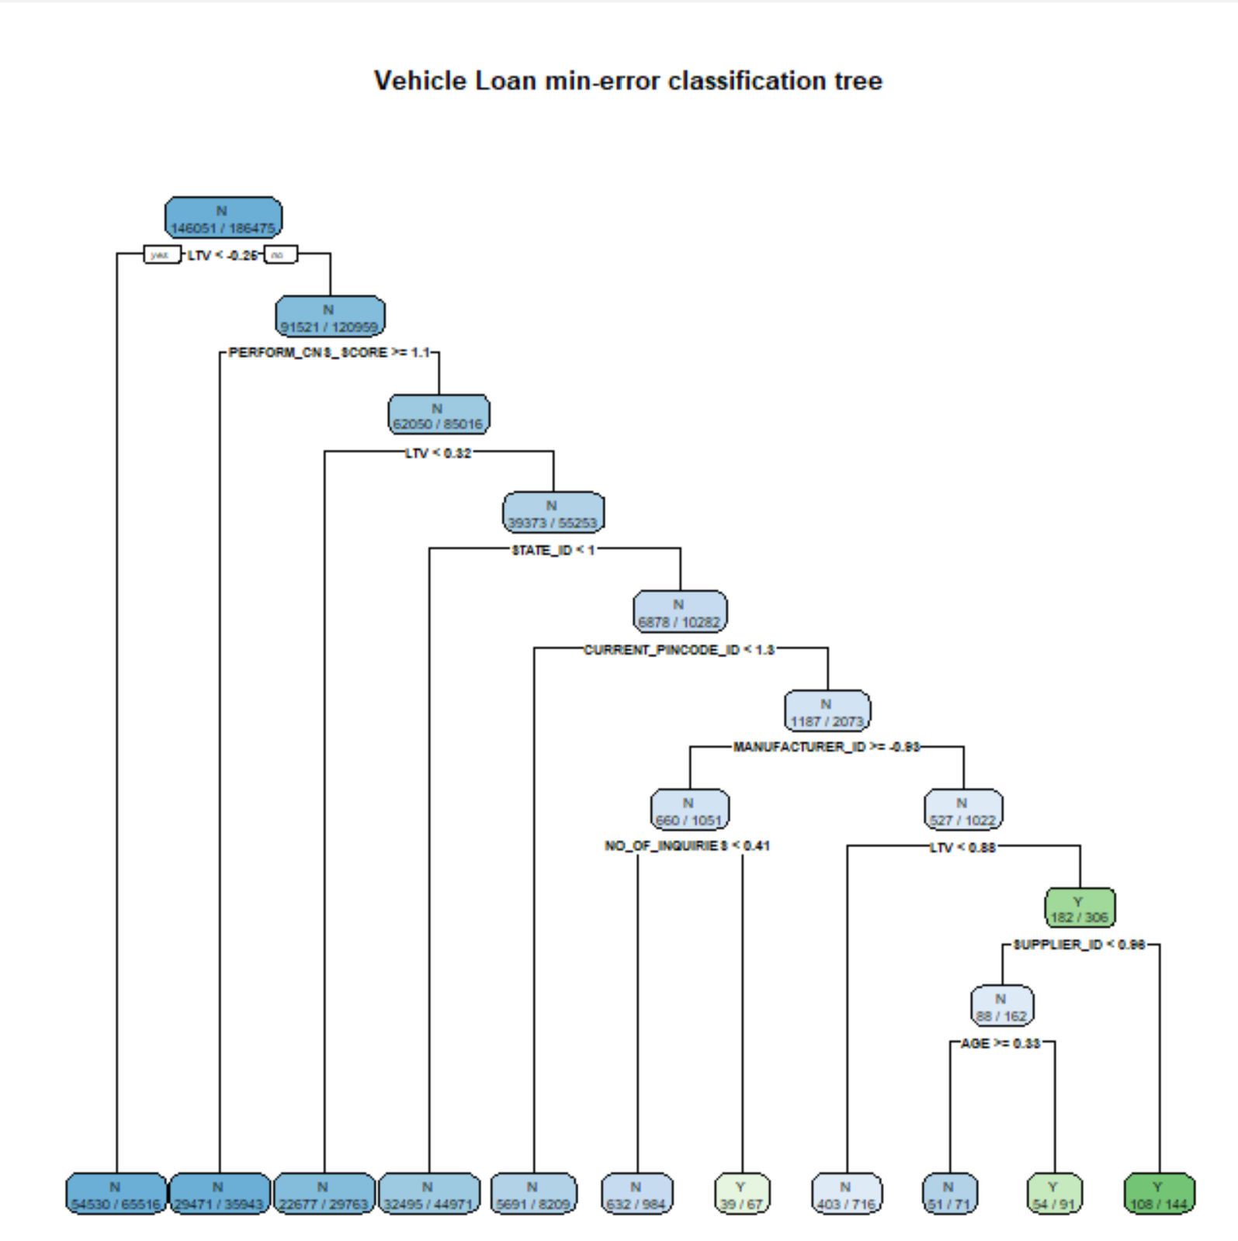
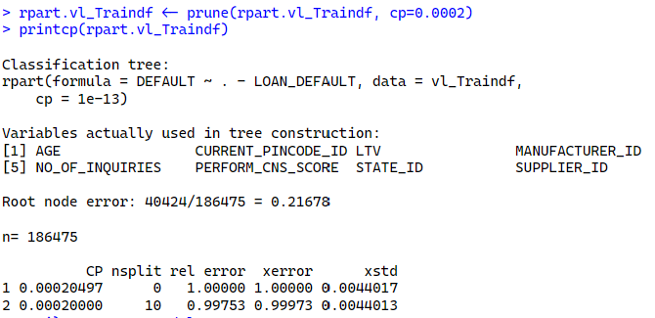
Predictive models
CART – Decision Tree
Fitting Classification Tree Using rpart
Notes:
The cross-validation results indicates the size of a tree . The smallest cross validated relative error and that to prune to this can use a cp=0.0002. A larger cp value will result in a smaller tree with less splits. A smaller cp value (example: cp=0.0000000000001) will result in a larger tree with more splits.

Slide 27
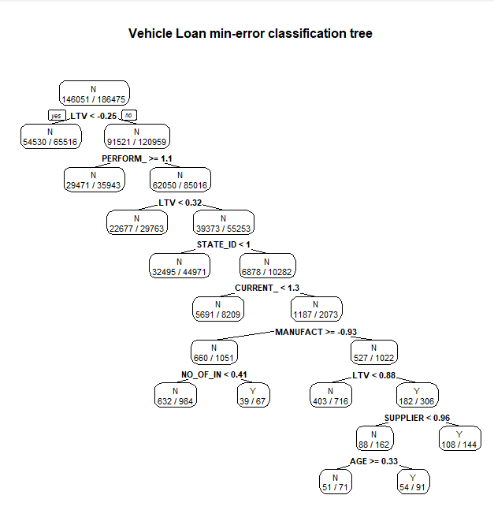
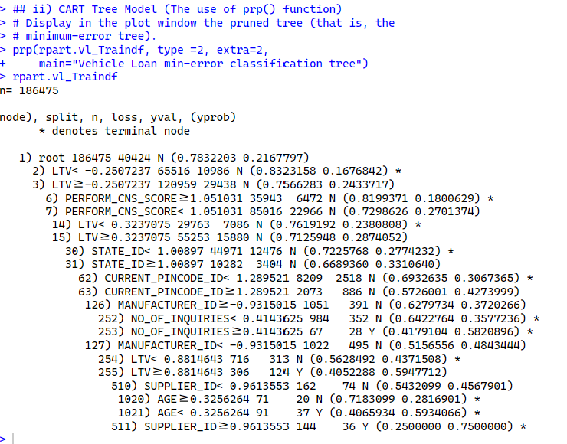
Predictive models
CART – Decision Tree
Fitting CART tree model prp() function
Notes:
Here, we use an important function, prp() in the R's CART (Classification and Regression Trees) package, which is used to visualize decision trees created by CART models. The function allows us to create a clear and informative graphical representation of the decision tree, which can help interpret the model and communicate its results.

Slide 28
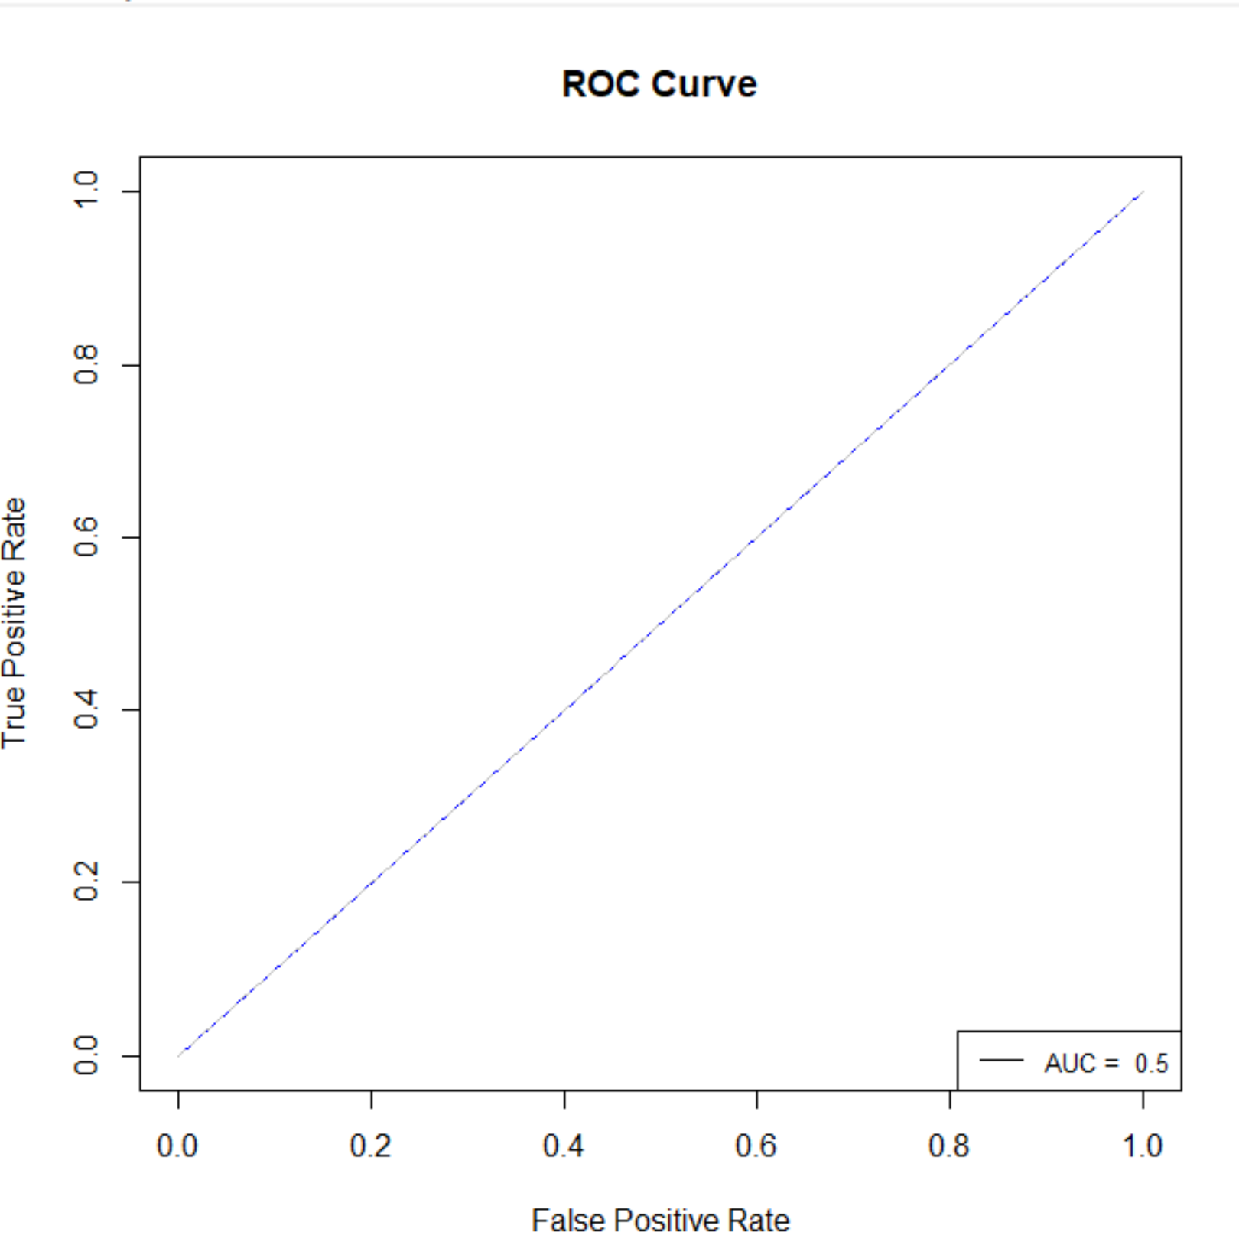
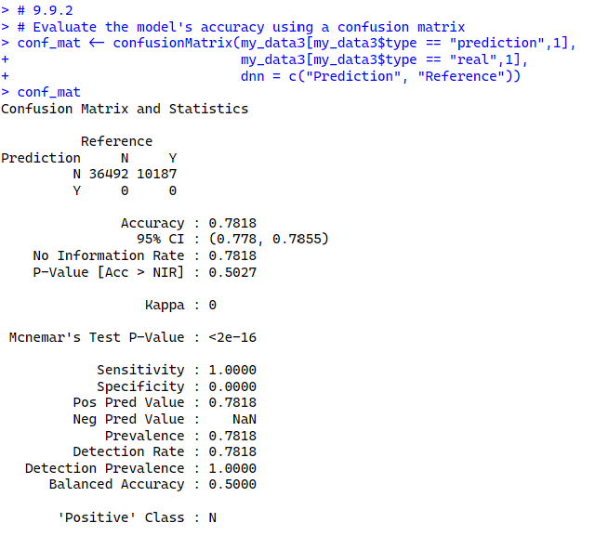
Predictive models
CART – Decision Tree
Confusion Matrix, ROC Curve & AUC
Accuracy | CI | P-Value | Mcnemar’s Test P-Value | Sensitivity
0.78 | 95% | 0.5 | <2e-16 | 1.0
Notes:
The McNemar's test (has a p-value of <2e-16) is a statistical test used to compare the performance of two classifiers or models on the same dataset.
Here we use the mcnemar.test function in R to perform McNemar's test on a confusion matrix generated by our CART model. This function takes the confusion matrix as its input and returns the test statistic (the chi-squared value), the degrees of freedom, and the associated p-value.
The p-value of McNemar's test is important because it indicates the statistical significance of the difference between the two classifiers. A low p-value (typically below 0.05) indicates that the difference is statistically significant, meaning that one classifier performs significantly better than the other on the dataset. On the other hand, a high p-value (typically above 0.05) suggests that there is no significant difference in performance between the two classifiers.
The confusion matrix shows the number of observations that were correctly classified (true positives and true negatives) and incorrectly classified (false positives and false negatives) by the model. The rows of the matrix represent the true class of the observations, while the columns represent the predicted class. The diagonal of the matrix shows the number of correct predictions, while the off-diagonal elements show the number of incorrect predictions.
Calculate statistics: The confusionMatrix function also calculates a number of statistics based on the confusion matrix, including accuracy, precision, recall, F1 score, and the area under the ROC curve. These statistics provide additional information about the performance of the model.
Interpret the statistics: Accuracy is the proportion of correct predictions, while precision is the proportion of true positives among all predicted positives. Recall is the proportion of true positives among all actual positives. The F1 score is a harmonic mean of precision and recall that balances between the two metrics. The area under the ROC curve measures the trade-off between sensitivity and specificity for different classification thresholds.
Here, we use the ROC curve and AUC (Area Under the ROC Curve) to evaluate the performance of classification models.
The ROC curve and AUC provide a visual and quantitative measure of how well a classification model, such as a CART model, is performing. Specifically, the ROC curve plots the true positive rate (TPR) against the false positive rate (FPR) at different classification thresholds, while the AUC provides a single number (i.e., 0.5 in this case for the model) representing the overall performance of the model. Higher AUC values indicate better model performance.

Slide 29
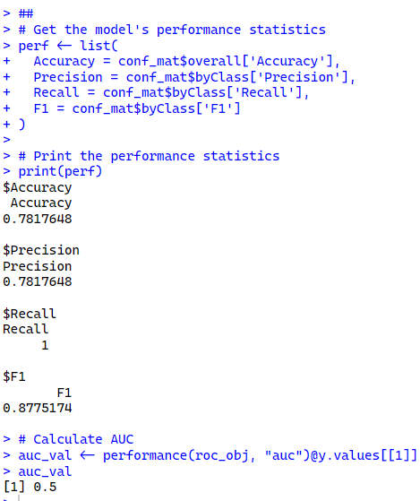
Predictive models
CART – Decision Tree
Model‘s Performance Statistics
Accuracy | Precision | Recall | F1 | AUC
0.78 | 0.78 | 1.00 | 0.88 | 0.5
Notes:
The McNemar's test (has a p-value of <2e-16) is a statistical test used to compare the performance of two classifiers or models on the same dataset.
Here we use the mcnemar.test function in R to perform McNemar's test on a confusion matrix generated by our CART model. This function takes the confusion matrix as its input and returns the test statistic (the chi-squared value), the degrees of freedom, and the associated p-value.
The p-value of McNemar's test is important because it indicates the statistical significance of the difference between the two classifiers. A low p-value (typically below 0.05) indicates that the difference is statistically significant, meaning that one classifier performs significantly better than the other on the dataset. On the other hand, a high p-value (typically above 0.05) suggests that there is no significant difference in performance between the two classifiers.
The confusion matrix shows the number of observations that were correctly classified (true positives and true negatives) and incorrectly classified (false positives and false negatives) by the model. The rows of the matrix represent the true class of the observations, while the columns represent the predicted class. The diagonal of the matrix shows the number of correct predictions, while the off-diagonal elements show the number of incorrect predictions.
Calculate statistics: The confusionMatrix function also calculates a number of statistics based on the confusion matrix, including accuracy, precision, recall, F1 score, and the area under the ROC curve. These statistics provide additional information about the performance of the model.
Interpret the statistics: Accuracy is the proportion of correct predictions, while precision is the proportion of true positives among all predicted positives. Recall is the proportion of true positives among all actual positives. The F1 score is a harmonic mean of precision and recall that balances between the two metrics. The area under the ROC curve measures the trade-off between sensitivity and specificity for different classification thresholds.
Here, we use the ROC curve and AUC (Area Under the ROC Curve) to evaluate the performance of classification models.
The ROC curve and AUC provide a visual and quantitative measure of how well a classification model, such as a CART model, is performing. Specifically, the ROC curve plots the true positive rate (TPR) against the false positive rate (FPR) at different classification thresholds, while the AUC provides a single number (i.e., 0.5 in this case for the model) representing the overall performance of the model. Higher AUC values indicate better model performance.

Slide 30
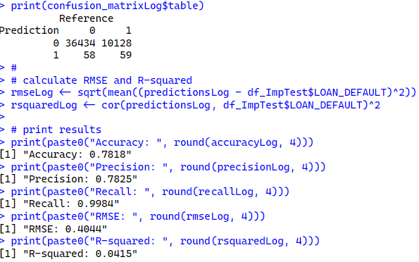
Predictive models
Predictive Models: Linear Classification Models
Logistic Regression
Accuracy | Precision | Recall | RMSE | R-squared
0.7817 | 0.7818 | 0.9984 | 0.4044 | 0.0415
Confusion Matrix | Reference
Prediction | 0 | 1
0 | 36434 | 10128
1 | 58 | 59
Notes:
Thank yo Faith for the in detail insights now this is For predictive modeling techniques we first utilized Logistic Regression where we found the accuracy as 78.17%, which at first seemed to be decent, while looking at the confusion matrix it was observed that the prediction was not done correctly as there were more false positive and false negative values. So, we thought to proceed with other classification model.

Slide 31
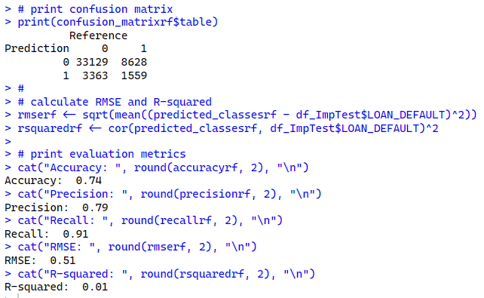
Predictive models
Predictive Models: Linear Classification Models
Random Forest with n=5
Accuracy | Precision | Recall | RMSE | R-squared
0.74 | 0.79 | 0.91 | 0.51 | 0.01
Confusion Matrix | Reference
Prediction | 0 | 1
0 | 33129 | 8628
1 | 3363 | 1559
The Random Forest model runs well, as it has predicted more accurately than the other n values.
Notes:
Here we look at Random Forest, where the ntree value =5 gave out good results, here while looking at the accuracy is 74% and the confusion matrix is that there are more correct values in true positive and true negative. Now let us take a look at the other n values used to run the model.

Slide 32
Predictive models
Predictive Models: Linear Classification Models
Random Forest continue…
N value | Accuracy | Precision | Recall | RMSE | R-squared
10 | 0.76 | 0.79 | 0.95 | 0.49 | 0.01
4 | 0.75 | 0.79 | 0.92 | 0.5 | 0
6 | 0.76 | 0.79 | 0.93 | 0.49 | 0.01
Reference N=10 | Reference
Prediction | 0 | 1
0 | 34645 | 9218
1 | 1847 | 969
Reference N=4 | Reference
Prediction | 0 | 1
0 | 33740 | 8945
1 | 2752 | 1242
Reference N=6 | Reference
Prediction | 0 | 1
0 | 34114 | 9058
1 | 2378 | 1129
Notes:
As we see the different n values taken for running the model. Here all the values have almost close accuracies, where the difference is observed in the confusion matrix which more accurately predicts the outcome.
*** If asked ---> Here n=500 was also utilized which gave the same results.

Slide 33
Predictive models
Predictive Models: Models Comparison
Preprocessing: Box-Cox Transformation (11); Centering (26); Ignored (4); Scaled (26)
Models: Classification Tree, Logistic Regression, Random Forest
Model | N-Value | Accuracy | Precision | Recall | F1 | AUC | RMSE | R-Squared
LS |  | 0.78 | 0.78 | 0.99 | - | - | 0.40 | 0.04
RF | 5 | 0.74 | 0.79 | 0.91 | - | - | 0.51 | 0.01
 | 10 | 0.76 | 0.79 | 0.95 | - | - | 0.49 | 0.01
 | 4 | 0.75 | 0.79 | 0.92 | - | - | 0.5 | 0
 | 6 | 0.76 | 0.79 | 0.93 | - | - | 0.49 | 0.01
CART | 186475 | 0.78 | 0.78 | 1.00 | 0.88 | 0.5 | - | -
Notes:
Coming on to the overall preview of the all the pre-processing, models run for the dataset, for Box-cox transformation, centering, Ignored, and Scaled values,
the accuracies, and precisions of the models are almost similar.

Slide 34
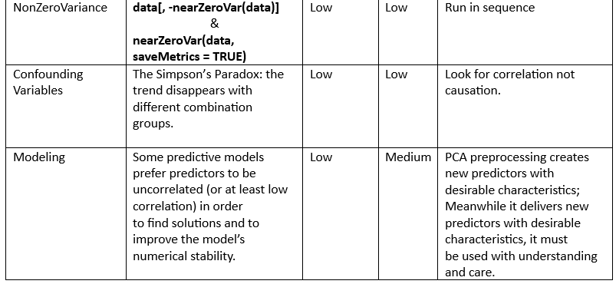
Roadblocks

Slide 35
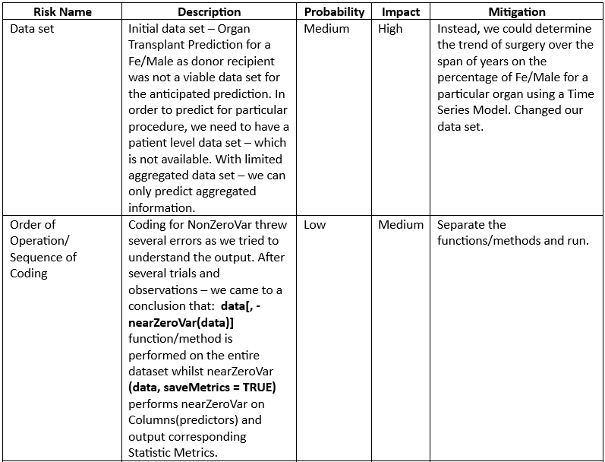
Roadblocks
Note: The initial risk as identified to be associated with the Organ Transplant dataset (OTD) has been mitigated with the replacement of the entire dataset with the Vehicle Loan data set. Thus, there is zero impact to the project since the OTD no longer exist.

Slide 36
conclusion
The risks and mitigations have been thoroughly dealt with up until halfway through the project. As we proceeded to the viable predictive model, we paid close attention to confounding variables as we may locate the Simpson’s Paradox as explained in the table.
From the entire output performance of each of the given methods in this project with the chosen data, it is apparent that results from preprocessing with PCA has a considerably low performance. On the contrary, the output results could be worse with PCA preprocessing.
Comparing the results in our previous slide (33), it is indicative that the Logistic Regression outperforms the Random Forest showing a larger R-Squared value of 0.04.
The CART model, the lower the cp (complex parameter) value the better the performance. The Mcnemar’s Test P-value determines if there are differences on a dichotomous dependent variable between two related groups. A dichotomous variable is a categorical variables with two categories only – which is the loan default column for either a Yes (1) or No (0). Also, with a P-value of <2e-16 which is less than 0.05 it is evident that there a significant difference between the categorical variables.
Based on the model comparison or in terms of model accuracy, CART and Logistics Regression models are the best.

Slide 37

Team VERSATILE - Questions

Slide 38
Backed-up slides
Back-up
Source: Dr. Gang (DAEN 690 Project Report Template)

Slide 39
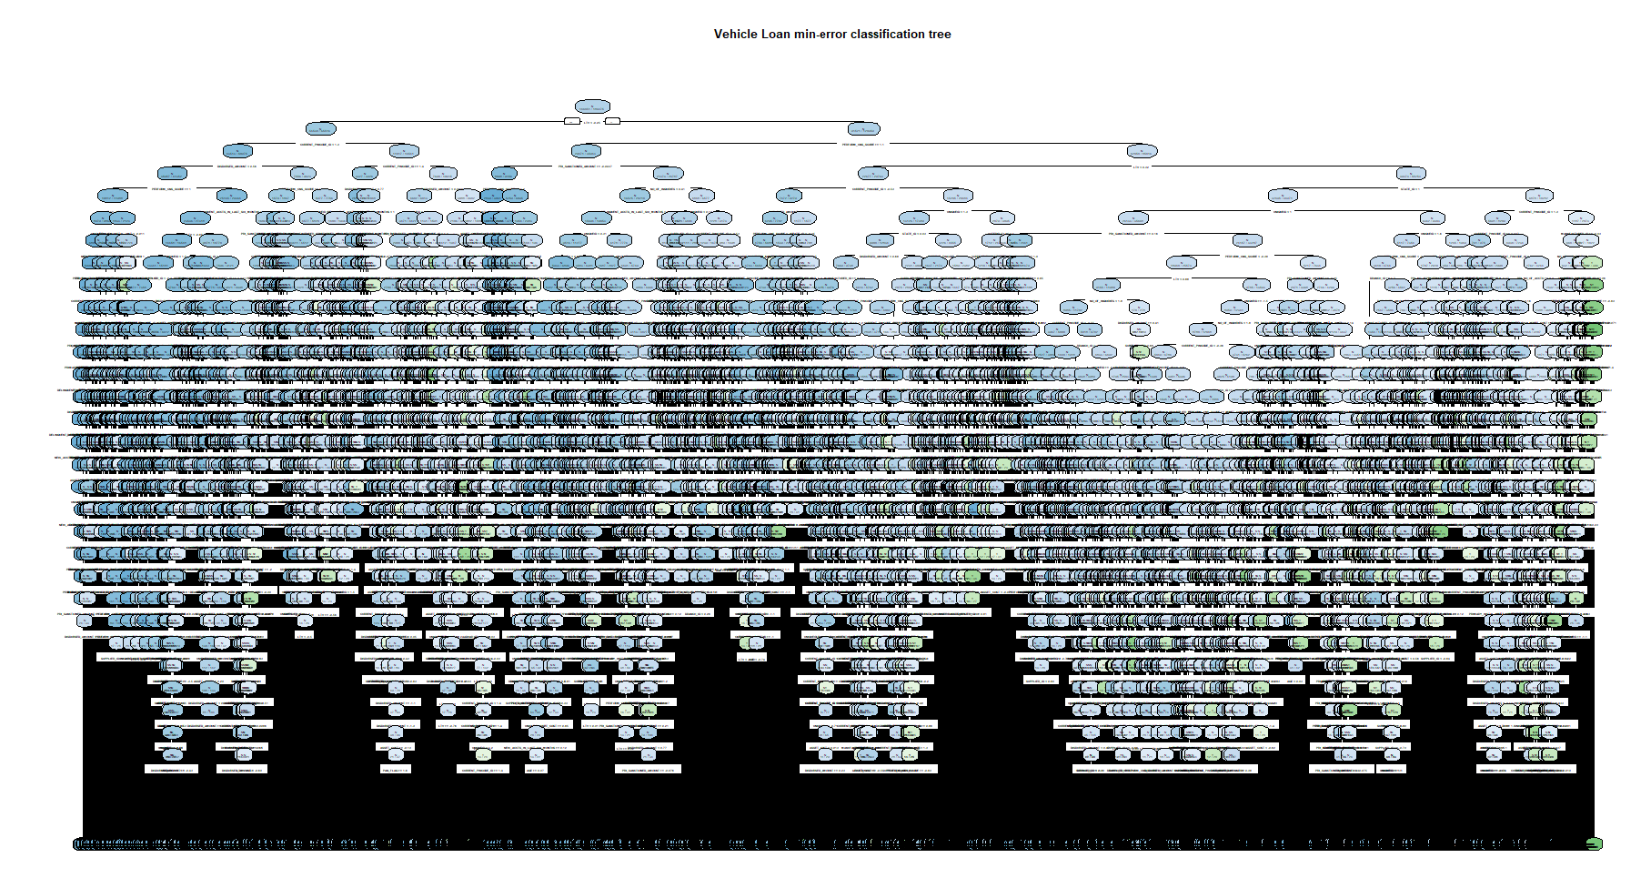
Predictive models
Predictive Models: Linear Classification Models
A smaller cp value (example: cp=0.0000000000001) will result in a larger tree with more splits, which lead to overfitting.

Slide 40
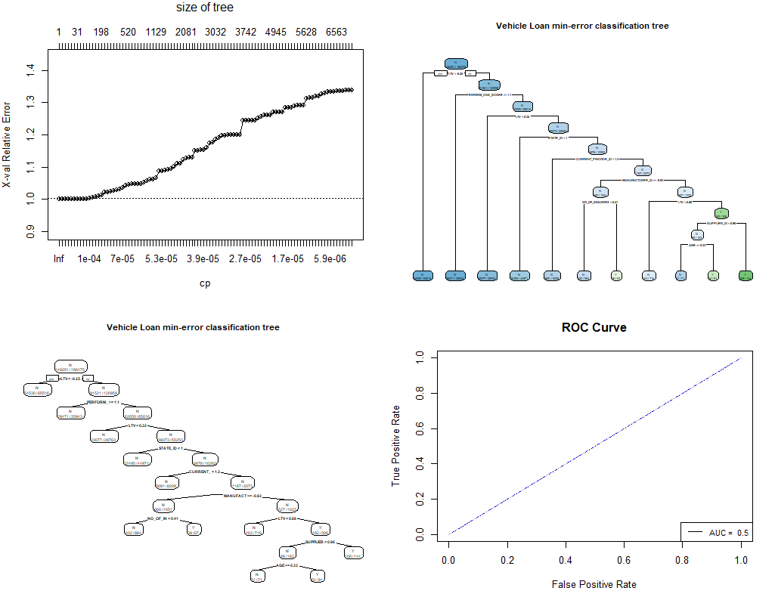
Backed-up slides
Source: Dr. Gang (DAEN 690 Project Report Template)

